Slide 1



Search for Long-Lived Particles with HCAL Segmentation in CMS at the Large Hadron Collider
Katia Avanesov, Harvey Newman, Kiley Kennedy, Gillian Kopp, Cristian Peña, Chris Tully, Si Xie
Katia Avanesov
Caltech SURF presentation 10/19/24

Slide 2
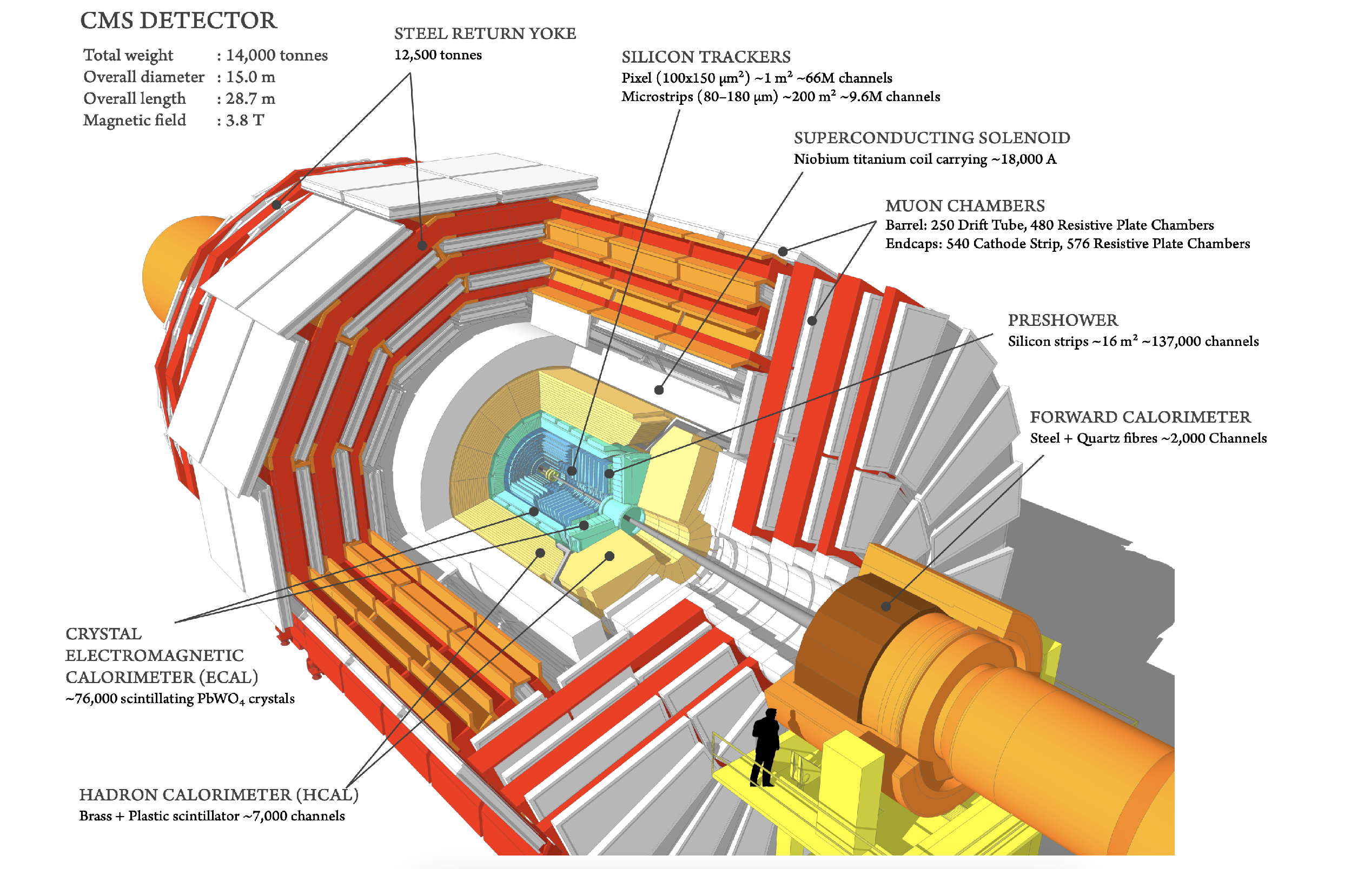
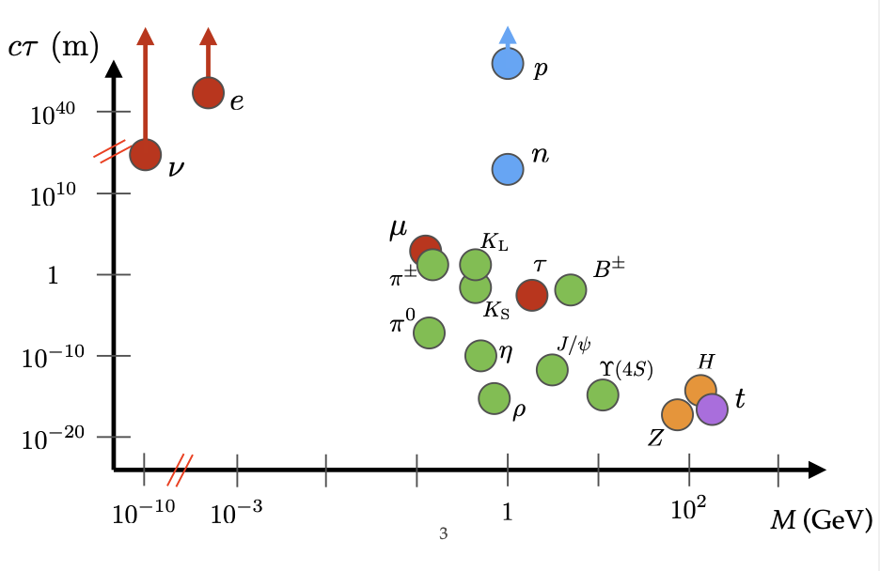
Long Lived Particles (LLPs)
LLPs have lifetimes greater than 0.1 nanoseconds
LLPs feature in both the Standard Model and predicted in numerous Beyond the Standard Model (BSM) theories
Katia Avanesov
Caltech SURF presentation 10/19/24
Notes:
Long lived particles can really be thought of as any particle with a lifetime of greater than 0.1 nanoseconds, before they decay and they’re not uncommon in the standard model, as we know we have electrons, protons and neutrinos which all live much longer, than that. What we’re interested in, is probing for long lived particles beyond the standard model, which translates to searching for particles in this region here. And one reason why we would want to do that is of course because there are many that have been predicted, in a lot of intersection of many important theories like the matter-antimatter asymmetry, or dark matter, and supersymmetry.
Actually the CMS detector is optimized for short-lived partciles that decay almost instantly like the Higgs boson. This is because all of its subdetectors are primarily for extracting information about the tracks of the decay particles, their charge, their energy and momenta to then reconstruct this into the original particle. All these compoents work together to piece together one actual particle. But what about for LLPs? – decaying to jets

Slide 3
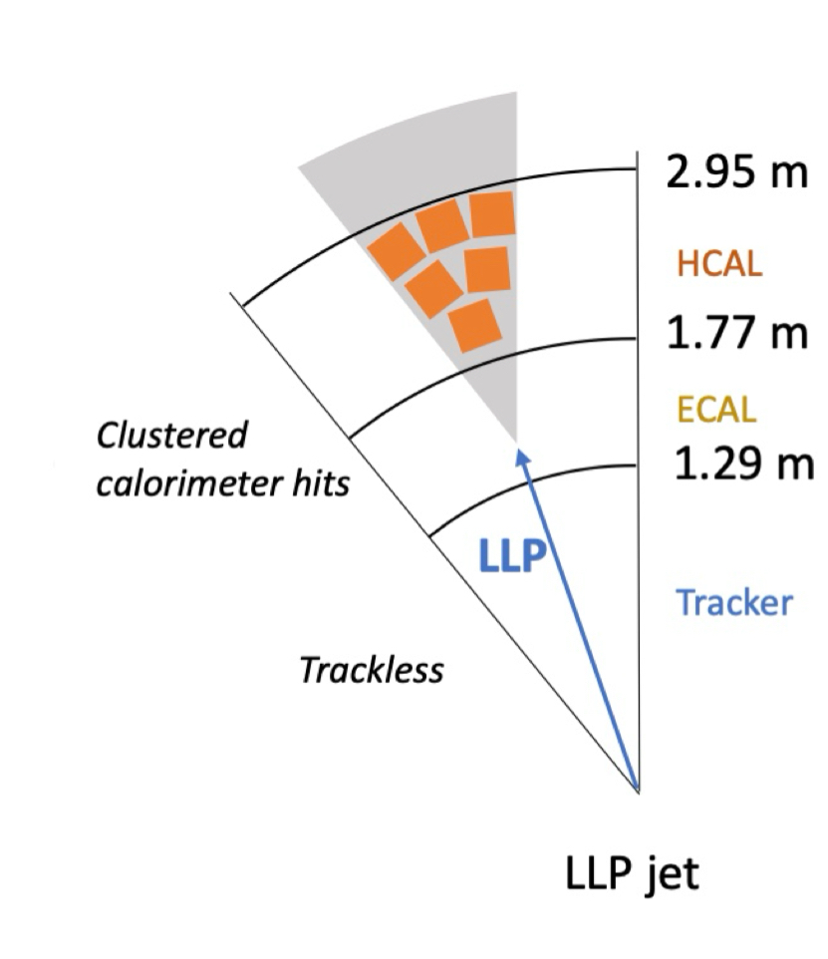
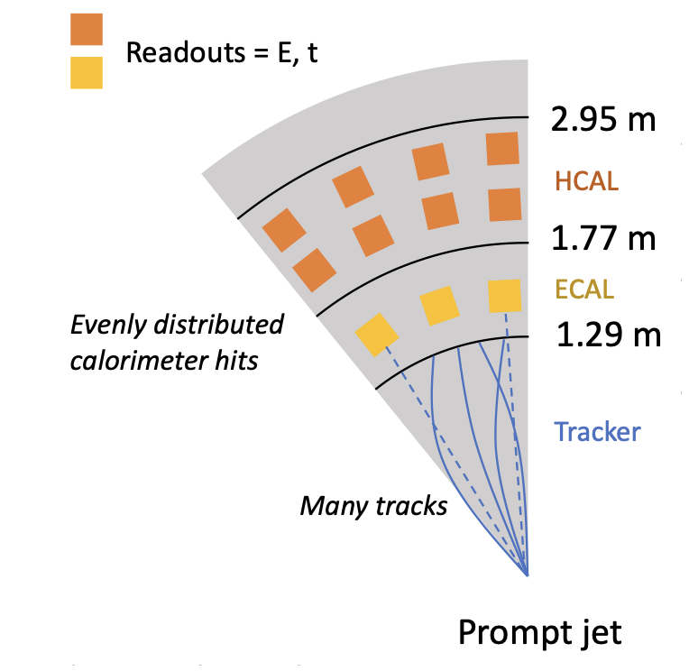
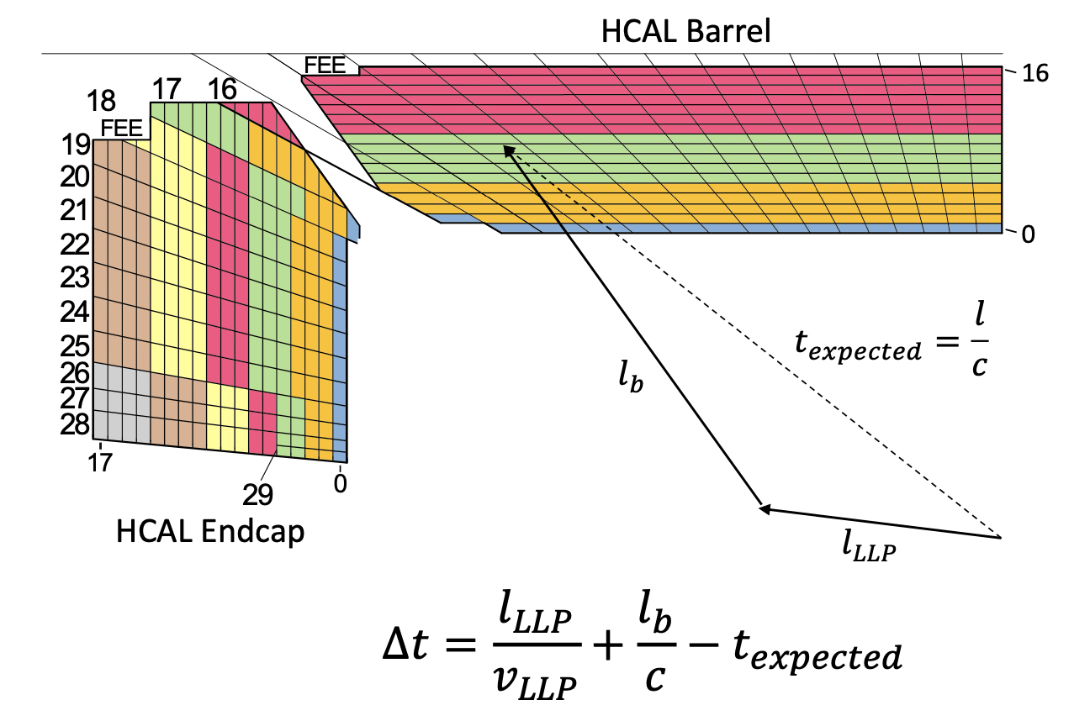
LLP Signatures
Trackless due to decays in the HCAL
Displaced vertex
Narrower energy spread
Longer lived particles will deposit less energy in the earlier layers of HCAL
Delayed due to longer lifetime and path length
Katia Avanesov
Caltech SURF presentation 10/19/24
Notes:
Well we can visualize the differences in the topology of tracks and jets produced by normal decaying vs delayed
Because the LLp has traveled a significant distance, far enough into the HCAl about 2-3m away from the beam line, all of its energy will be more clustered narrowly compared to a jet that came directly from the center. Furthermore, the LLP would have by-passed the ECAl and tracls, and therefore left very little information to work off of – by contrast, we see that the deposists are more abundant, spread out and messier.
Another important factor is time delay – because of the decay geometry, we would expect time delay not only because of path length, but also because of simply longer lived particles. 0-6ns and 6ns+ is delayed
So on one hand, yea, you’re not wrong in thinking that actually we have very little signatures for LLPs to go off of, but then – the absence of signature is a signature in and of itself? An yes, this is what our entire search strategy is based off of.

Slide 4
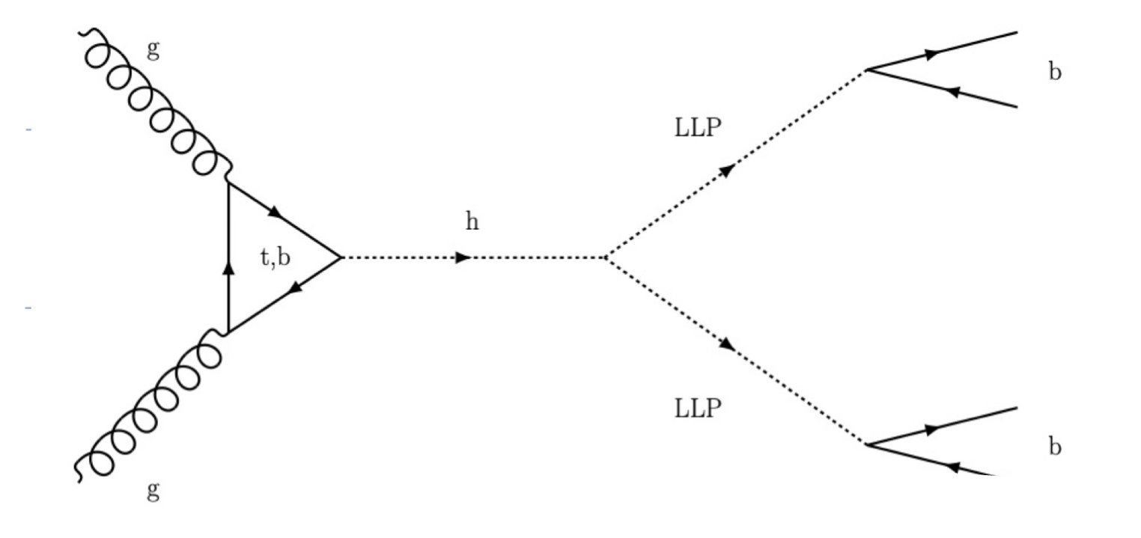
Search Strategy
Searching for H→ss→bbbb
Specifically within the HCAL: looking at HCAL decays
Online
Offline Analysis
Developed Level 1 Trigger to select LLP-matching events:
Higher energy fraction in HCAL segmentation
Time delay
Jet Energy threshold 40GeV
Selection of ≈100M events in 2023
Develop a powerful tagger/ classifier for selection of LLPs and rejection of background events
Katia Avanesov
Caltech SURF presentation 10/19/24
Notes:
And so yes our entire search strategy is on exploiting these differences, in the LLP signatures and what’s more, we are looking for decays within the HCAL because we see that this is where we could extract a lot of information, especially with the new updated HL-LHC upgrades. And so a broad outline of what has been done and ongoing work is here.
With the trigger in place, the core of this problem boils down to the offline analysis, and the way to further maximise signal and reject background to get overall better statistical significance for our final analsysis. And so while we have yet to actually produce our analysis, what we’ve been working on is developing the tools of successful analysis, which is this LLP classifier, which I was in charge of/ led.

Slide 5
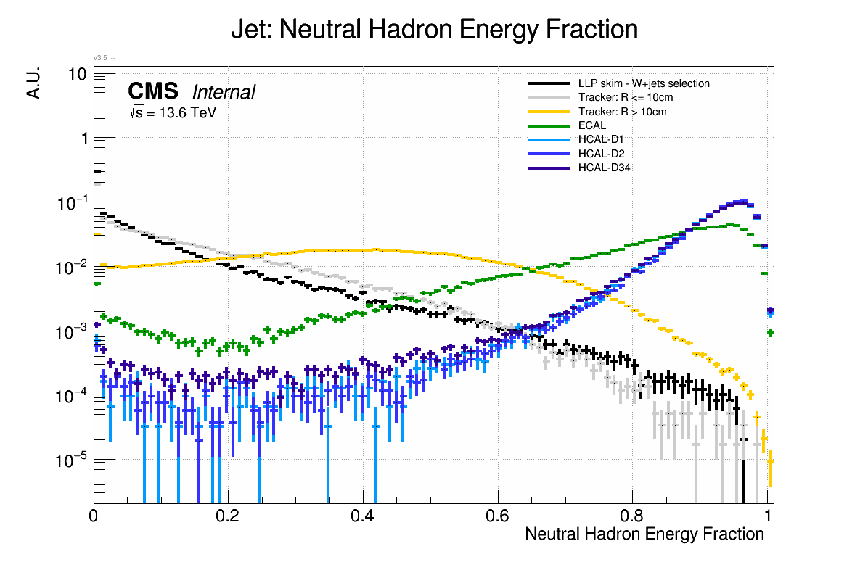
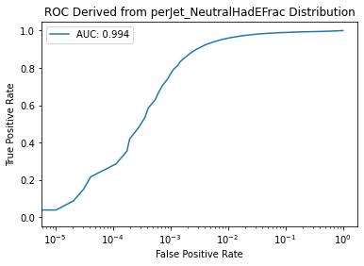
Sensitive Jet Object Variables
Gillian Kopp
Gillian Kopp
Katia Avanesov
Caltech SURF presentation 10/19/24
Notes:
From everything I’ve mentioned so far, this seems like a pretty easy task because we have seen just how distinct these LLP jets are so it shouldn’t be a real problem to classify them. And for the most part, you would be right because indeed we have quite a lot of powerful/ discriminating jet variables – by literally taking just one jet metric and using it as a score, we already get a ROC of 0.994 which is already impressive and we didn’t even need to do any work to get here. But suddenly, we see that as the background efficieny drops off, so does the signal efficiency quite drastically – and this region is what really matters to us. Lets not forget that the Higgs is a really rare process and we would expect only 10M events across the entirety of the Run 3 , and so if we have a dataset of events of just 100M events, we would expect far far fewer Higgs and so background rejection is realy important. If yiu have just 0.25 of your signal left but still b overwhelmed with background – and so this is why this work is a little less straightforward because we really want to maximise the curve in this region – and so this is what led to ou progression from using quite classical classification methods, such as boosted decision trees, through to machine learning methods and so now we can so=how some results.

Slide 6
Data (for training)
Higgs Mass [GeV] | LLP Mass [GeV]
125 | 15
125 | 15
125 | 15
125 | 50
125 | 50
250 | 120
350 | 80
350 | 160
Signal
MC-generated LLP events, based on different combinations of Higgs Mass and LLP Mass; Each file contains roughly 100k entries (reduces to 30-70k after pre-selections)
Background
Run3 Skim for W+ Jets ≈ 80M events
Training only performed against W+ jets (one source of background)
Katia Avanesov
Caltech SURF presentation 10/19/24
Notes:
So before I get more into the details justthe context

Slide 7
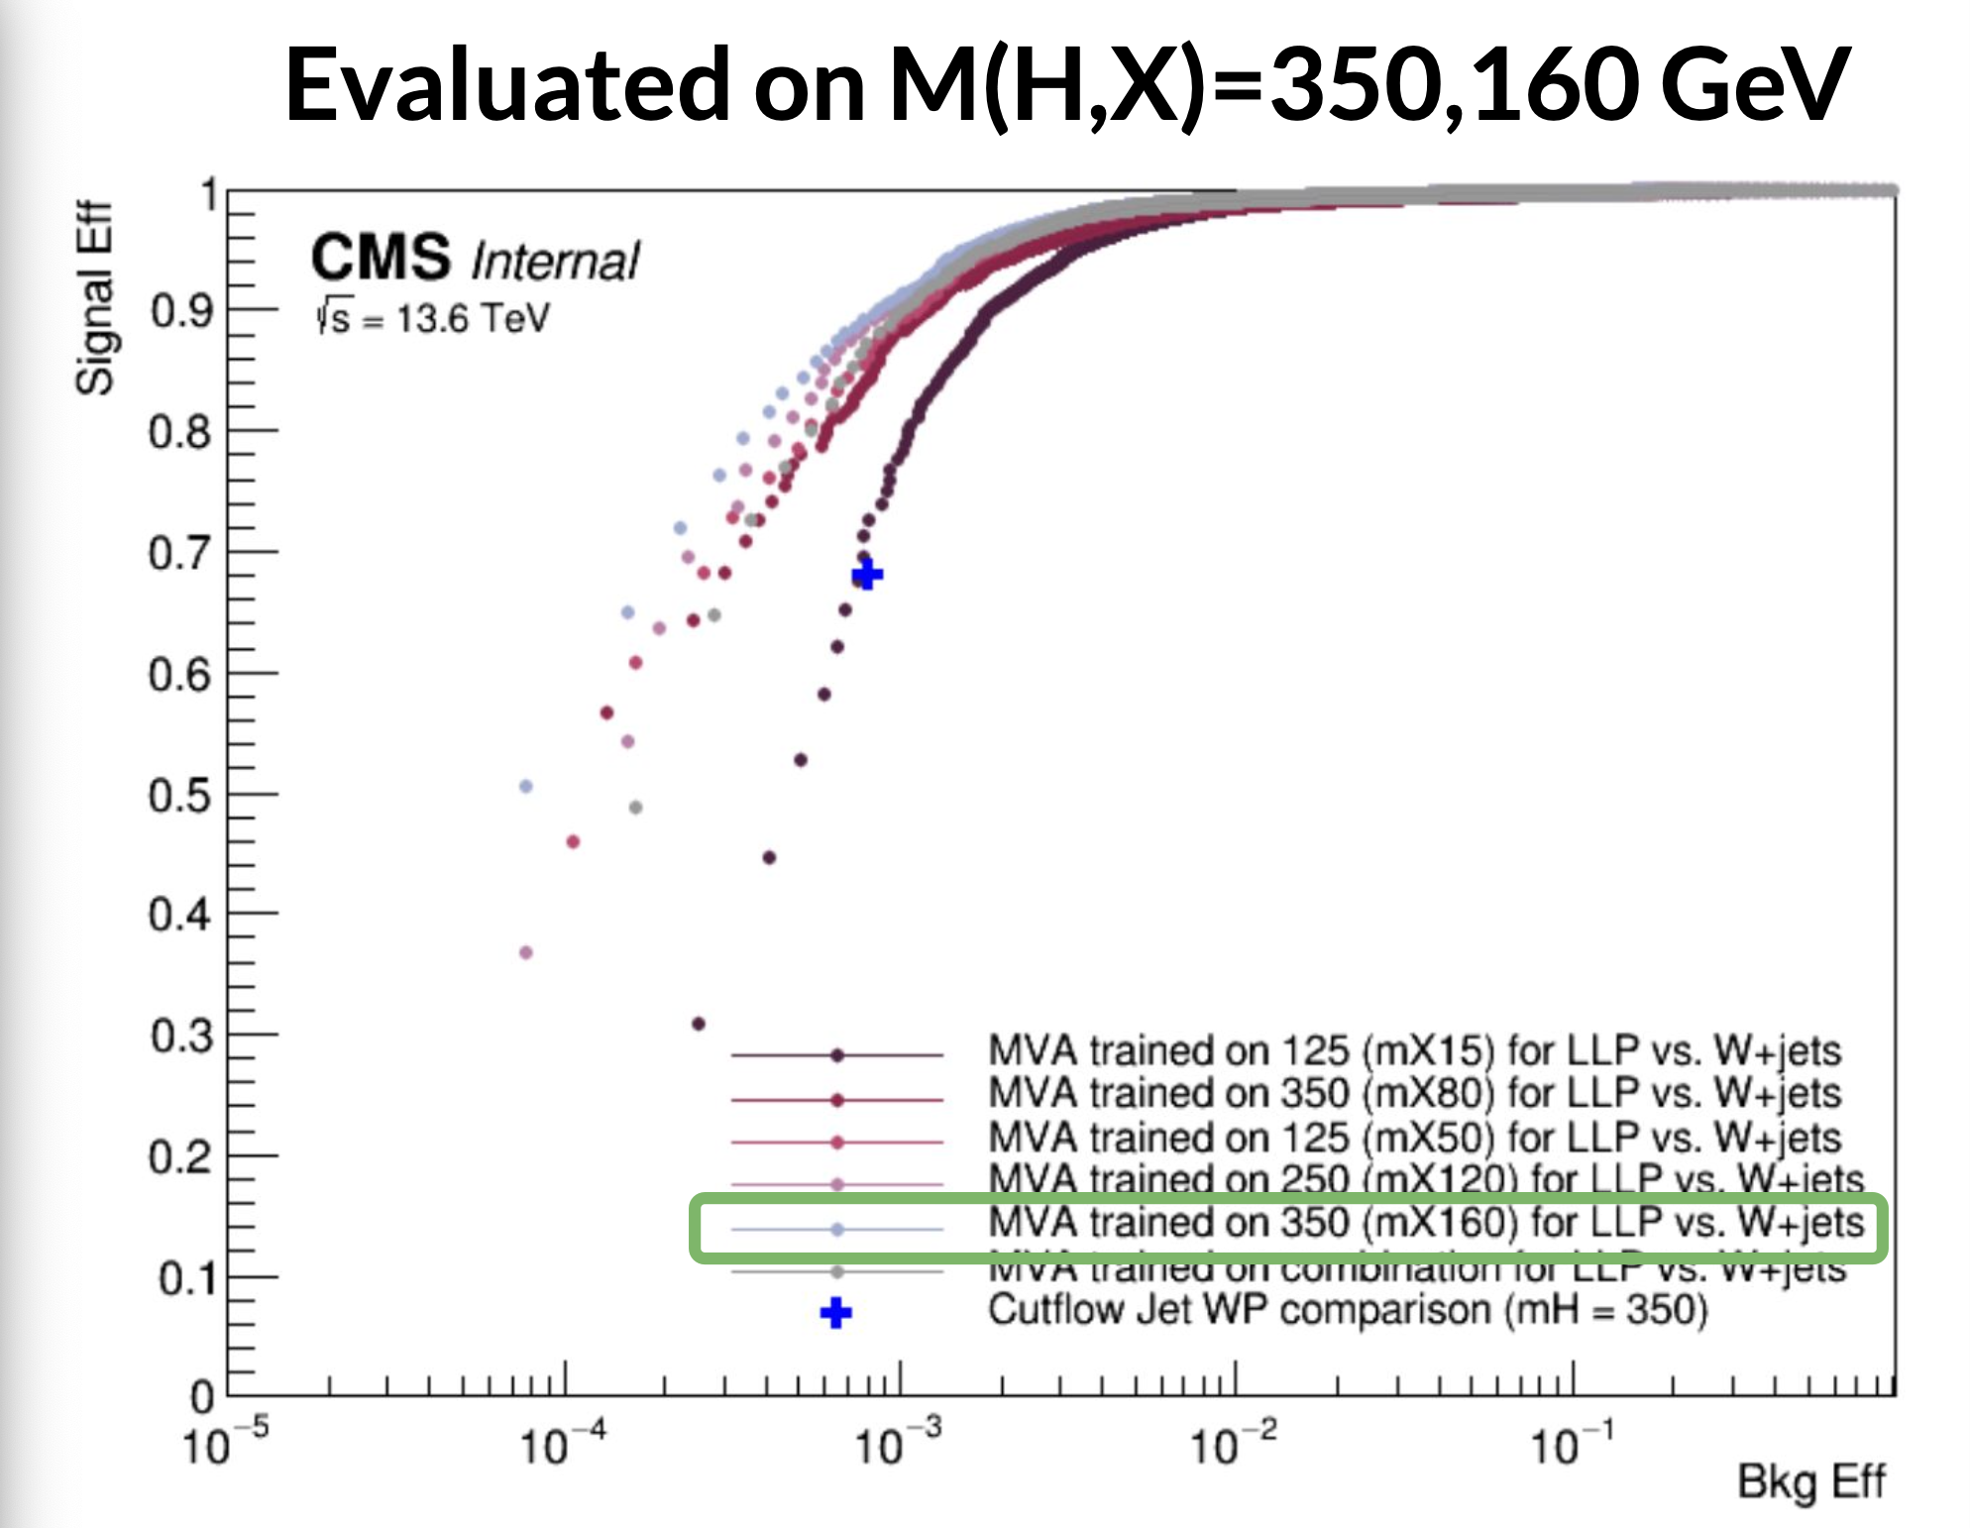
Multi-Variate Analysis Framework: Gradient-Boosted Decision Tree
Katia Avanesov
Caltech SURF presentation 10/19/24

Slide 8
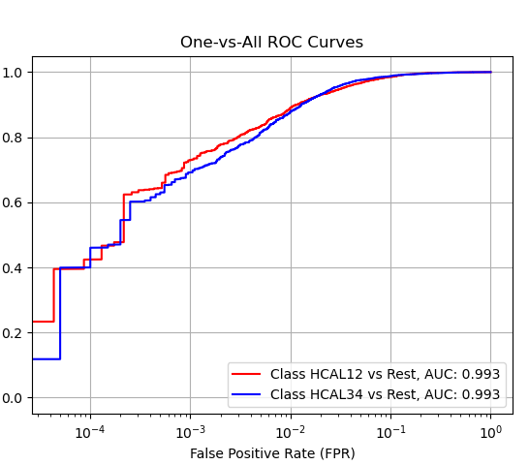
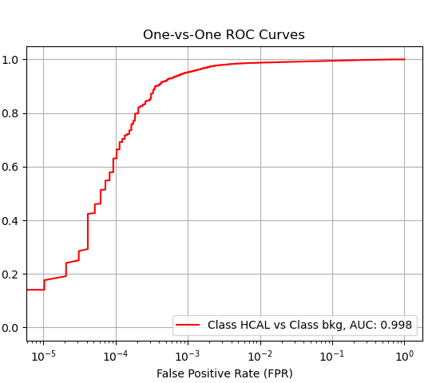
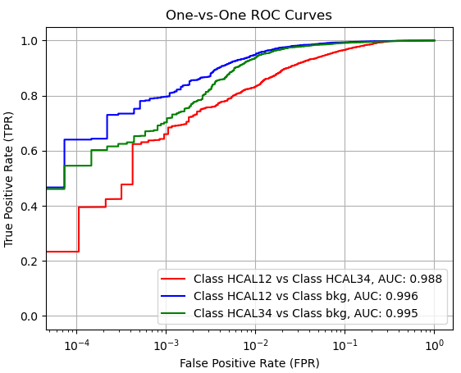
Dense NN (Multi-)Classifier: MH350-MS160
BDT
Katia Avanesov
Caltech SURF presentation 10/19/24

Slide 9
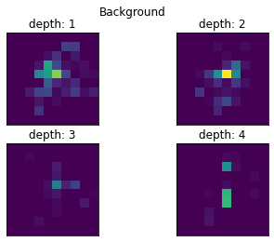
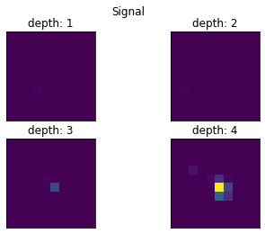
Training on 3D Jet Images
3D Image Sample from Signal and Background
Katia Avanesov
Caltech SURF presentation 10/19/24

Slide 10
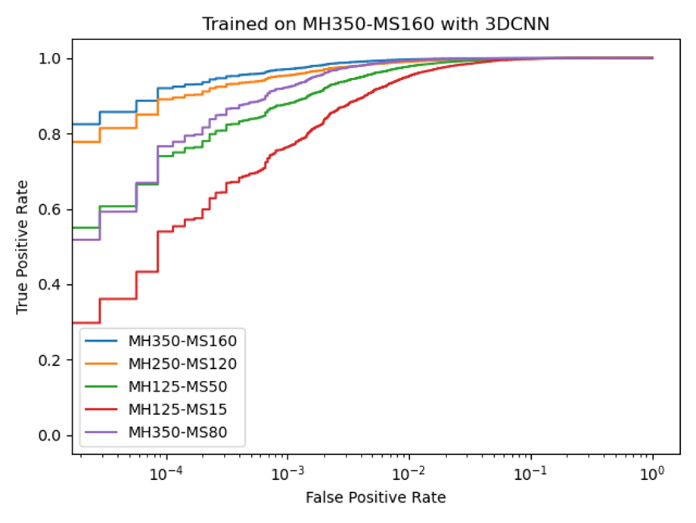
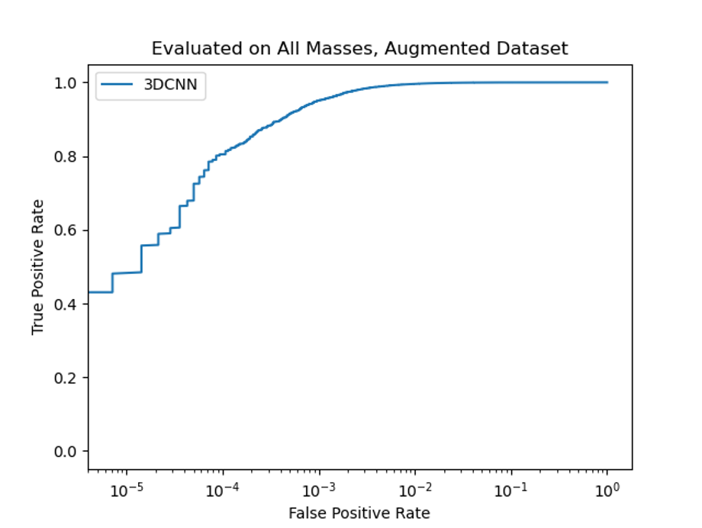
3DCNN Results
Dense-NN
BDT
Katia Avanesov
Caltech SURF presentation 10/19/24

Slide 11
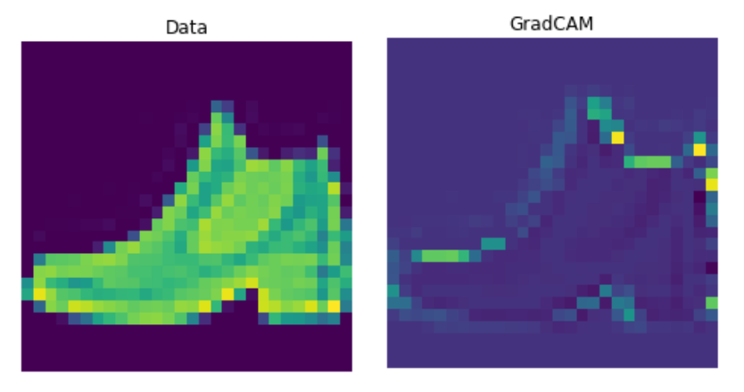
GradCAM: Gradient-Weighted Class Activation Mapping
Pass image through last convolution layer (extracts highest level features)
Take gradient of final output score with respect to each input pixel using backpropagation
Apply ReLU and use gradients to weight importance of filters/ feature maps to Conv layer output when taking a weighted average to obtain a single output map
Katia Avanesov
Caltech SURF presentation 10/19/24

Slide 12
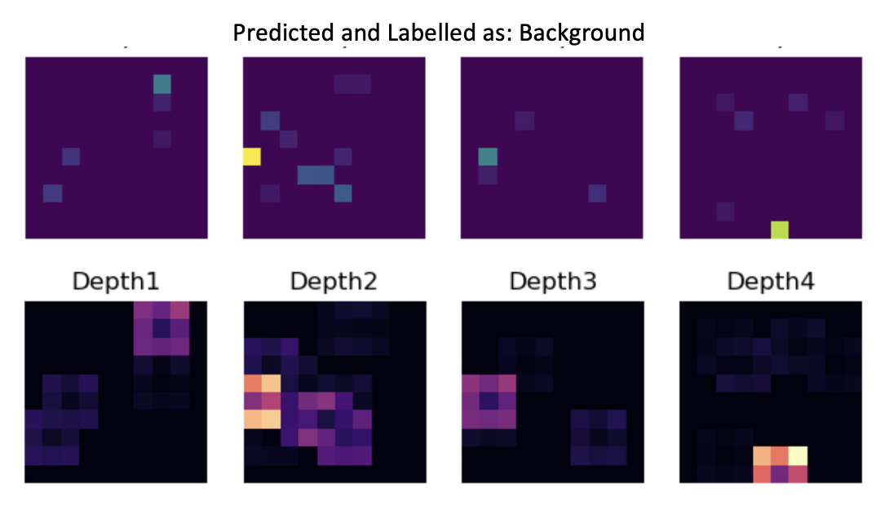
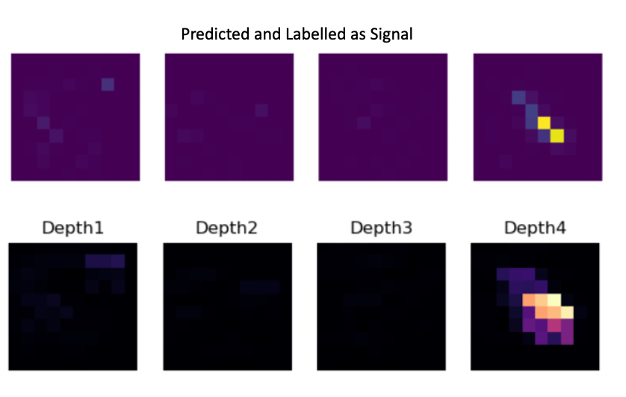
Applying GradCAM to Jet Images
Background GradCAM:
Model sees only individual, localized hot towers
Even when towers are close-by, an overlap of the 3x3 kernel shape is seen
Surroundings activated more than the center
Signal GradCAM:
Activation pattern mimics the shape of the jet cluster
Model perceives nearby hot towers as one energy cluster
Katia Avanesov
Caltech SURF presentation 10/19/24

Slide 13
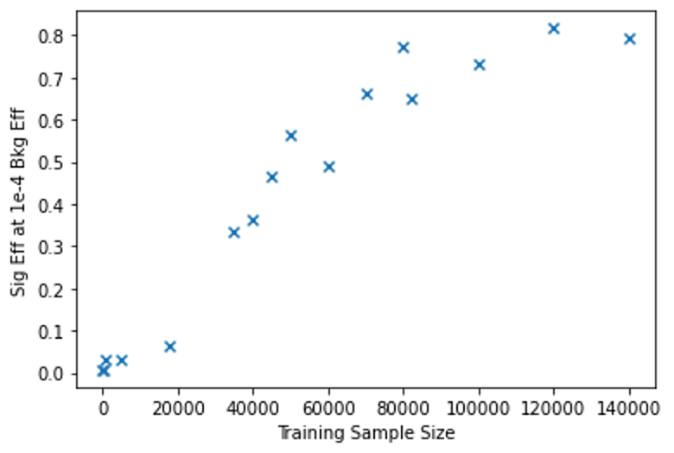
Conclusion and Future Steps
Promising exploration of machine learning-based methods for tagging delayed jets and identifying long-lived particles.
Each model exhibits some degree of interpretability.
Most notable achievement so far is a 90% signal efficiency at just 0.01% background efficiency (3D Jet Image tagger).
Possible exploration of more advanced classification methods
Plots of TPR evaluated at FPR = 1e-4 vs the amount of training data provided (evaluating samples are constant)
Katia Avanesov
Caltech SURF presentation 10/19/24

Slide 14

Thank You
I am grateful to Professor Harvey Newman and Kiley Kennedy for their mentorship
and I thank the Samuel P. and Frances Krown SURF Fellowship
Katia Avanesov
Caltech SURF presentation 10/19/24

